Slide 1

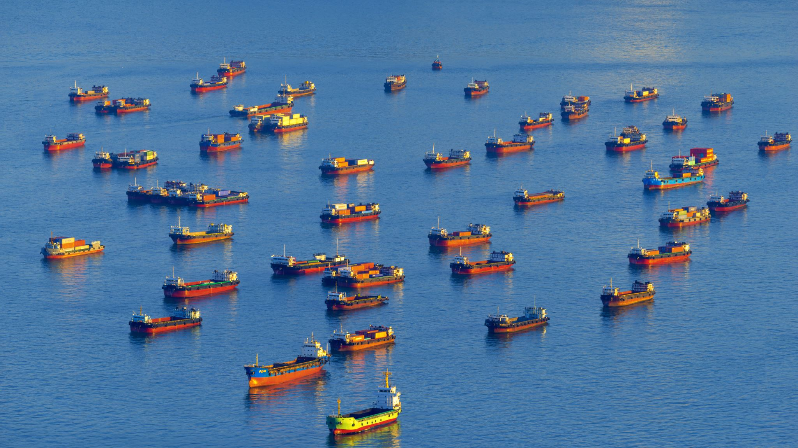

Transporte im Roten Meer brechen weiter ein
By Benjamin Suljevic & Adrian Zeitlberger

Slide 2

General information
Title: Transporte im Roten Meer brechen weiter ein
Date: 07.02.2024
Publisher: Die Presse
Content:
Attacks by Houthi rebels in the Red Sea contributed to the decline.
this, global trade volume rose in January, nearing pre-pandemic levels.
The Chinese New Year likely boosted trade activity temporarily

Slide 3

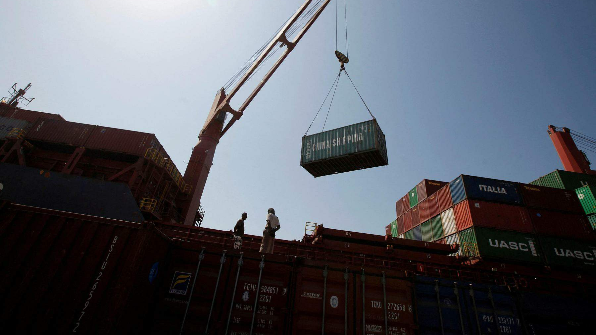

Our Questions
Which routes do they take now ?
How long will this delay the transports ?
What are the Consequences ?

Slide 4

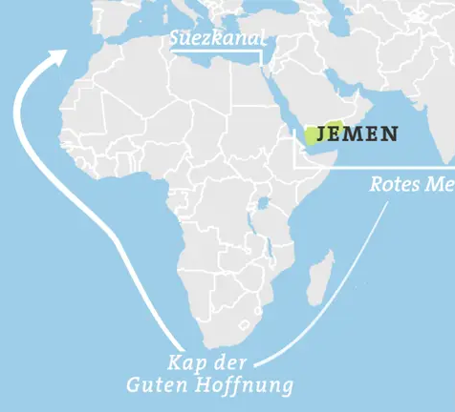

Which routes do they take now?
Before: Through Red Sea And Suezkanal
Now: Through cape of good hope (Around Africa)

Slide 5

How long will this delay the transports?
2 weeks

Slide 6

What are the Consequences?
Short Terms:
80% LESS CONTAINER PASSED IN JANUARY THE SUEZ CANAL THAN EXPAECTED
Costs From China to Europe raise from 1500$ to 5000$ (Per 40-Feet-Container)
(During Corona Pandemic:15000$)
Long terms:
nothing

Slide 7
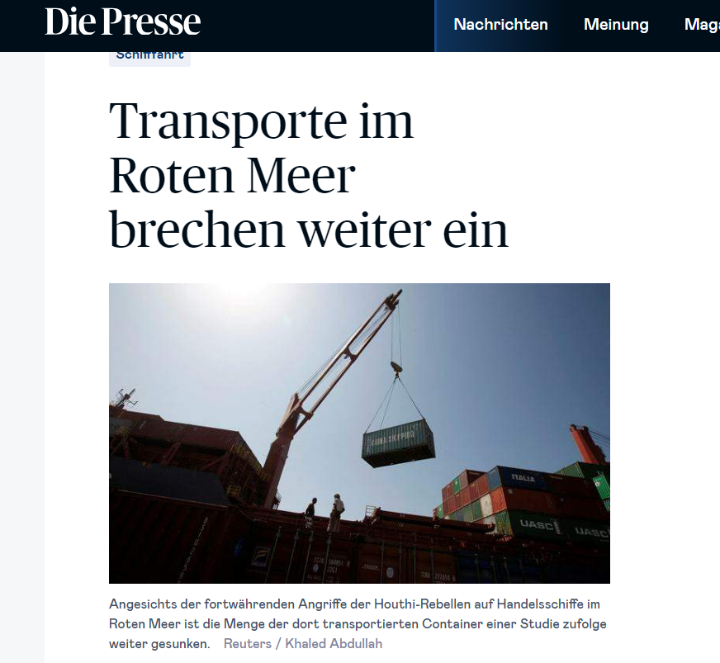

Source information
https://www.diepresse.com/18075254/transporte-im-roten-meer-brechen-weiter-ein?ref=reco_a_ga

Slide 8


opinion
Why we choose this article? (Expactions)
Benjamin is a great consumer
Perfect for 3 questions
What do we think of this Article?
We would like to get more information about the rebel-attacks

Slide 9
Thanks for Your Attention

